Slide 1
Waiting for the Op/Ed?
Connecting our reading to writing

Slide 2

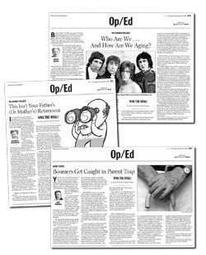
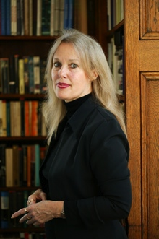
Novel, Debate, Writing

Slide 3
Waiting for the Barbarians
Page 136
“We are all subject to the law, which is greater than any of us…”
“all creatures come into the world bringing with them the memory of justice. ‘But we live in a world of laws…a world of the second- best.’”
“When some men suffer unjustly… it is the fate of those who witness their suffering to suffer the shame of it.”

Slide 4
Dershowitz (LAW) Scarry
“I have argued that unless a democratic nation is prepared to have a proposed action governed by the rule of law, it should not under-take, or authorize, that action.” (185)
“We are asked to assume that a judge or executive branch officer…will be able to discriminate between acceptable and unacceptable cases.” (199)

Slide 5
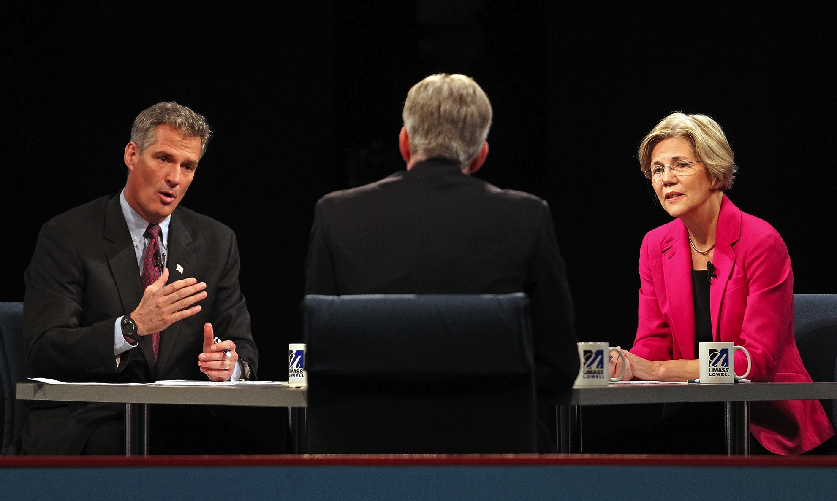
Public Debate

Slide 6
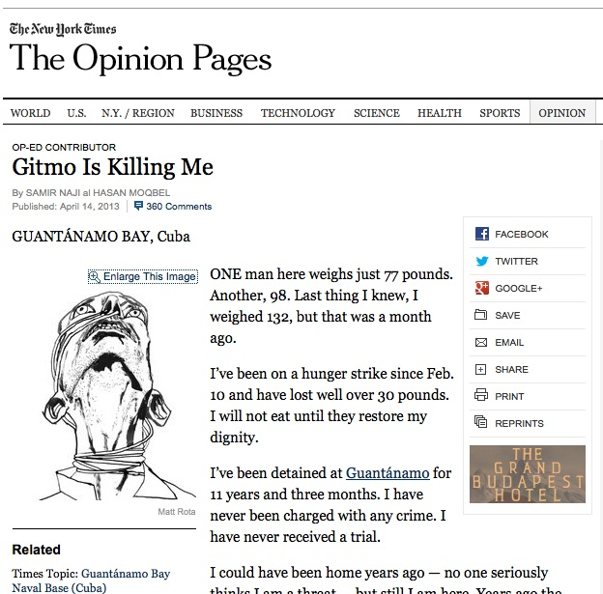
Op/Ed Pages

Slide 7
“Gitmo Is Killing Me”
One man here weighs just 77 pounds. Another, 98. Last thing I knew, I weighed 132, but that was a month ago.
I’ve been on a hunger strike since Feb. 10 and have lost well over 30 pounds. I will not eat until they restore my dignity.
I’ve been detained at Guantánamo for 11 years and three months. I have never been charged with any crime. I have never received a trial.
Samir Naji al Hasan Moqbel
http://www.nytimes.com/2013/04/15/opinion/hunger-striking-at-guantanamo-bay.html?_r=2&

Slide 8
Preparing your Op/Ed
Be clear about your perspective – what do you want to say?
Review your notes
Organize your arguments and counter-arguments.
How do you want to build an ethos in the writing?
What type of voice do you want to have?
Remember you are writing for a general audience.

Slide 9

Draw from range of materials

Slide 10


